Slide 1
GeeCON 2012
16 – 18 May
Multikino Poznań

Slide 2
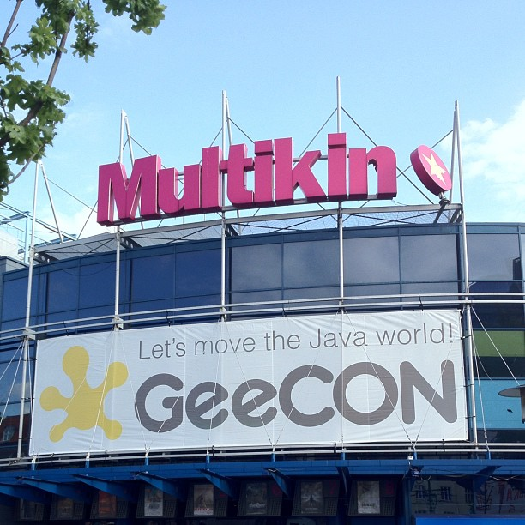
Arrival Day http://2012.geecon.org

Slide 3
University Day - Wednesday 16th May
Arun Gupta Java EE 6 = Less Code + More Power
slides: https://blogs.oracle.com/arungupta/resource/javaee6-hol-glassfish.pdf
Arun’s blog https://blogs.oracle.com/arungupta/entry/geecon_2012_trip_report
Twitter: @arungupta
Thomas Sundberg Behaviour Driven Development with Cucumber for Java
@thomassundberg
http://thomassundberg.wordpress.com/
http://cukes.info/ - Lecutre about testing java framework (like Junit, copetition for tumbler http://code.google.com/p/tumbler-glass/)
Jakub Marchwicki Hurdle run through testing EJB applications
@kubem
http://www.marchwicki.pl/blog
How to test EJB, treat them as java classes or add embeded openjdk
slides: http://t.co/ZaEM8TCZ
Bruce Eckel Atomic Scala
Author of famous book „Thinking in Java” firstly printed in 2000. He presented the syntaxt of new programing language scala.

Slide 4
Conference Day I - Thursday 17th May
Bruce Eckel The Power of Hybridization
Slides: http://tinyurl.com/ehybrid
Code: http://tinyurl.com/ehybridc
Ivar Jacobson Liberating the Essence from the Burden of the Whole: A Renaissance in Lean Thinking
http://blog.ivarjacobson.com/liberating-the-essence-from-the-burden-of-the-whole-a-renaissance-in-lean-thinking/
@ivarjacobson
Slides: http://www.ivarjacobson.com/resource.aspx?id=1234
Awesome show!
Best Quote: ‘Having many (non-coding) architects is a sign of failure in an organisation’
Gavin King Ceylon: the thinking behind a new language
http://relation.to/Bloggers/Gavin
Amazing new jvm language ceylon
Adam Bien Java EE--Or Who Cares About WebContainers?
http://www.adam-bien.com/roller/abien/entry/java_ee_and_how_to
Adam Bien Interactive On-stage Hacking With Java EE
Amazing live javaee6 coding
Keith Braithwaite Measuring the Effect of TDD on Design
http://peripateticaxiom.blogspot.com/
@keithb_b
Anton Arhipov Mastering Java bytecode with ASM

Slide 5
Conference Day II - Friday 18th May
Peter Hilton Play Framework 2.0
http://hilton.org.uk/
@PeterHilton
http://www.playframework.org/ - amazing java framework for web apps
Pawel Wrzeszcz Visibility Shift in Distributed Teams
pawel.wrzesz.cz/blog/
Slides: http://prezi.com/lrosc_z0pzy0/visibility-shift-in-distributed-teams/
Krzysztof Kliś,Przemyslaw Szeremiota Allegro Search: Solr In Action
Allegro search engine http://lucene.apache.org/solr/
Wojciech Seliga How to survive automated tests hell
http://www.spartez.com/pl/ludzie-agile-developers/wojciech-seliga.html
http://unimplemented.blogspot.com
Kevlin Henney Cool Code
http://kevlin.tel
@KevlinHenney
http://www.youtube.com/watch?v=xyCRPRKBPAI

